Slide 1
Representation Invariants and Abstraction Functions

Slide 2
Announcements
Exam 1 on Monday Feb. 26th
  Closed book/phone/laptop, 2 cheat pages allowed
  Reasoning about code, Specifications, ADTs
  I will post Review slides and practice tests off Announcements page by next Thursday
Spring 18 CSCI 2600, K. Kuzmin, A Milanova

Slide 3
Announcements
Graded HW0, now grading HW1
HW2 due tomorrow
HW3 out tomorrow and due next Thursday
  Start early!!!
Spring 18 CSCI 2600, K. Kuzmin, A Milanova

Slide 4
Outline
Specifying an ADT
  immutable
  mutable
Reasoning about ADTs
  Representation invariants (rep invariants)
  Representation exposure
  Checking rep invariants (check rep)
  Abstraction functions
Spring 18 CSCI 2600, K. Kuzmin, A Milanova

Slide 5
Dafny Lab
You may have to add a Dafny function to state
the postcondition. E.g., pow2(n):
function pow2(n: nat): nat
{ if n == 0 then 1 else 2*pow2(n-1) }
Trailing Zeros
Precondition: x > 0
zeros = 0;
y = x;
while (y%10 == 0) {
y = y/10;
zeros = zeros + 1;
}
Postcondition: x = y*10^{zeros} && y%10 != 0
Write TrailingZeros in Dafny
Verify your program with Dafny
Submit your Dafny code on Submitty, “Dafny exercise 2”,
Deadline 11:59:59pm on Friday.
(Note on next page.)
Notes:
Could be quite nontrivial.
We do get better with practice.
Even with practice, loop invariants are tough to guess, when programs get more complex.
In fact, finding/guessing loop invariants is an active area of research.

Slide 6
Dafny Lab
Note: it may be easier to verify the program if you specify input and output parameters as nat, not int.
method trailingZeros(x: nat) returns (y: nat, zeros: nat)
requires …
ensures …
{
…
}
Notes:
Could be quite nontrivial.
We do get better with practice.
Even with practice, loop invariants are tough to guess, when programs get more complex.
In fact, finding/guessing loop invariants is an active area of research.

Slide 7
Designing Data Structures
From domain concept
  E.g., the math concept of a polynomial, an integer set, the concept of a library item, etc.
through ADT
  Describes domain concept in terms specification fields and abstract operations
to implementation
  Implements ADT with representation fields and concrete operations
Spring 18 CSCI 2600, K. Kuzmin, A Milanova

Slide 8
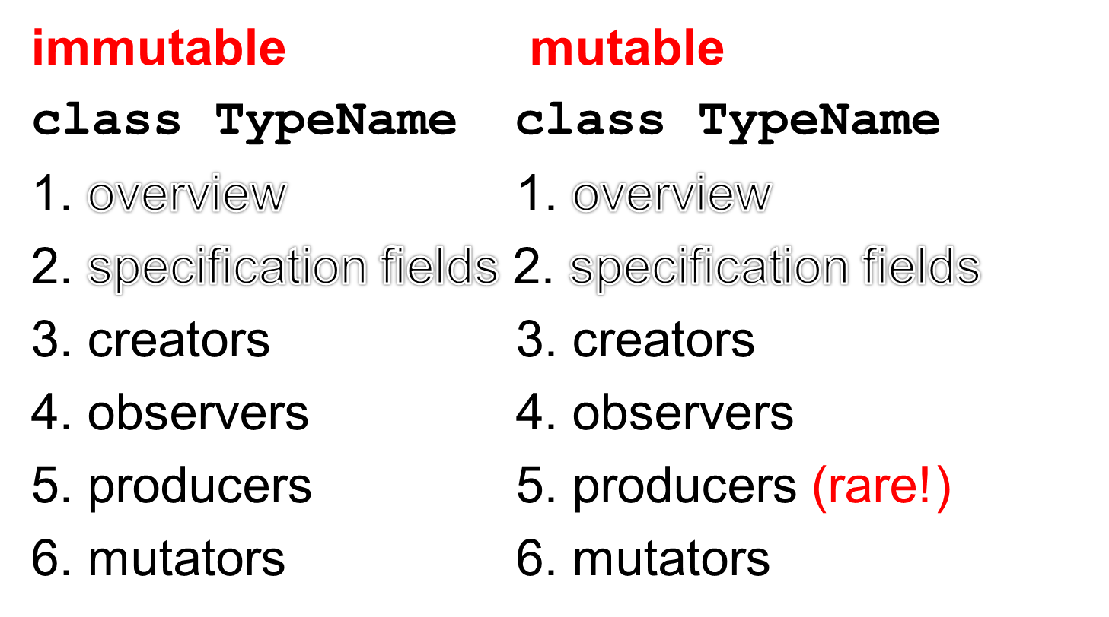
Specifying an ADT
Spring 18 CSCI 2600, K. Kuzmin, A Milanova (slide by Michael Ernst)

Slide 9
Poly, an immutable datatype: overview
/**
* A Poly is an immutable polynomial with
* integer coefficients. A Poly is:
* c₀ + c₁x + c₂x² + …
*/
class Poly {
Overview: Always state whether mutable or immutable
Define abstract model for use in specification of
operations. In ADTs state is abstract, not concrete (i.e.,
this are NOT actual, implementation fields of Poly, just
specification.)
Specification (abstract) fields.
More on this later.
Spring 18 CSCI 2600, K. Kuzmin, A Milanova (slide due to Michael Ernst)

Slide 10
Poly, an immutable datatype: creators
// modifies: none
// effects: makes a new Poly = 0
public Poly()
// modifies: none
// effect: makes a new Poly = cx^{n}
// throws: NegExponentException if n < 0
public Poly(int c, int n)
Creators: This is example of overloading, two Poly
constructors with different signatures.
New object is part of effects not preexisting state. Hence, modifies is none.
Spring 18 CSCI 2600, K. Kuzmin, A Milanova (slide due to Michael Ernst)

Slide 11
Poly, an immutable datatype: observers
// returns: degree of this polynomial
public int degree()
// returns: the coefficient of the term of
// this polynomial, whose power is d
public int coeff(int d)
Observers: Used to obtain information about this
polynomial. Return values of other types. Never modify
the abstract state!
this: the current Poly object. Also called the receiver
Poly x = new Poly(5,4)
int c = x.coeff(3);
Spring 18 CSCI 2600, K. Kuzmin, A Milanova (slide due to Michael Ernst)

Slide 12
Poly, an immutable datatype: producers
// modifies: none
// returns: a new Poly with value this + q
public Poly add(Poly q)
// modifies: none
// returns: a new Poly with value this*q
public Poly mul(Poly q)
Producers: Operations on a type that create other objects
of the same type. Common in immutable types. No side
effects, i.e., cannot change _abstract_ values of any
existing object
Spring 18 CSCI 2600, K. Kuzmin, A Milanova (slide due to Michael Ernst)

Slide 13
IntSet, a mutable datatype: overview, creators and observers
/** Overview: An IntSet is a mutable,
* unbounded set of integers. E.g.,
* { x₁, x₂ , … x_{n} }
*/
class IntSet {
// effects: makes a new empty IntSet
public IntSet()
// returns: true if x in this IntSet,
else false
public boolean contains(int x)
Spring 18 CSCI 2600, K. Kuzmin, A Milanova (slide due to Michael Ernst)
Notes:
You will have to specify the “modifies” clause! I omit due to space constraints.

Slide 14
IntSet, a mutable datatype: mutators
// modifies: this
// effects: this_{post} = this_{pre} U { x }
public void add(int x)
// modifies: this
// effects: this_{post} = this_{pre} - { x }
public void remove(int x)
Mutators: operations that modify receiver this. Rarely
modify anything other than this. Must list this in modifies: clause. Typically, mutators have no return value.
Spring 18 CSCI 2600, K. Kuzmin, A Milanova (slide due to Michael Ernst)

Slide 15
Exercise: String
Overview?
  Immutable!
Creators?
  String(), String(char[] value),
  String(String original), …
Observers?
  charAt, compareTo, contains, endsWith, …
Producers?
  concat, format, substring, …
Mutators?
  None!

Slide 16
Exercise: The Stack datatype
  public Stack()
  public boolean empty()
  public E peek()
  public int search(Object o)
public E push(E item)
public E pop()
Notes:
Does it have any producers?

Slide 17
Example: Python Datatypes
Tuples (e.g., (1,”John”)) Lists (e.g., [1,2])
are immutable are mutable
[j] [j]
len(t) len(l)
[j:k] [j:k]
+ +
* *
l.append(e)
l.reverse()
Spring 18 CSCI 2600, K. Kuzmin, A Milanova

Slide 18
Why ADTs?
Bridges gap between domain concept and implementation
Formalizes domain concept. We can reason about correctness of the implementation
Shields client from implementation. Imple-mentation can vary without affecting client!
Spring 18 CSCI 2600, K. Kuzmin, A Milanova

Slide 19
Reasoning About ADTs
ADT is a specification, a set of operations
  E.g., contains(int i), add(int i), etc., (the IntSet ADT)
  add(Poly q), mul(Poly q), etc., (the Poly ADT)
When specifying ADTs, there is no mention of data representation!
When implementing the ADT, we must select a specific data representation
Spring 18 CSCI 2600, K. Kuzmin, A Milanova
Notes:
So far our main concern was to SPECIFY THE ADT.

Slide 20
Implementation of an ADT is Provided by a Class (Java, C++)
To implement the ADT
  We must select the representation, the rep
  Implement operations in terms of that rep
  E.g., rep of our Poly can be
  a) int[] coeffs or
  b) List<Term> terms
Choose representation such that
  It is possible to implement all operations
  Most frequently used operations are efficient
Spring 18 CSCI 2600, K. Kuzmin, A Milanova (modified from Michael Ernst, UW)
Notes:
But which ones will those most frequently used operations be???

Slide 21
Connecting Implementation to Specification
Representation invariant: Object → boolean
  Indicates whether data representation is well-formed. Only well-formed representations are meaningful
  Defines the set of valid values
Abstraction function: Object → abstract value
  What the data structure really means
    E.g., array [2, 3, -1] represents –x² + 3x + 2
  How the data structure is to be interpreted
Spring 18 CSCI 2600, K. Kuzmin, A Milanova (based on slides by Michael Ernst)
Notes:
But how do we know that our implementation is correct?

Slide 22
IntSet ADT
/** Overview: An IntSet is a mutable set
* of integers. E.g., { x₁, x₂ , … x_{n} }, {}.
* There are no duplicates.
*/
// effects: makes a new empty IntSet
public IntSet();
// modifies: this
// effects: this_{post} = this_{pre} U { x }
public void add(int x);
// modifies: this
// effects: this_{post} = this_{pre} - { x }
public void remove(int x)
// returns: (x in this)
public boolean contains(int x)
// reruns: cardinality of this
public int size()

Slide 23
One Possible Implementation
The representation (the rep)
class IntSet {
private List<Integer> data
= new ArrayList<Integer>();
public void add(int x) { data.add(x); }
public void remove(int x) {
data.remove(new Integer(x));
}
public boolean contains(int x) {
return data.contains(x);
}
public int size() { return data.size(); }
}
Notes:
Question: Why I’m using autoboxing at add, and contains, but not at remove?
NOTE: What can go wrong with this implementation?

Slide 24
The Representation Invariant
s = new IntSet();
s.add(1); s.add(1); s.remove(1);
The representation invariant tells us what’s wrong with this code:
  class IntSet {
  // Rep invariant:
  // data has no nulls and no duplicates
  private List<Integer> data; …
Spring 18 CSCI 2600, K. Kuzmin, A Milanova

Slide 25
The Representation Invariant
States data structure well-formedness
  E.g., IntSet objects, whose data array contains duplicates, e.g., [1,1], are ill-formed
Must hold before and after every concrete operation!
Correctness of implementation depends on it
Spring 18 CSCI 2600, K. Kuzmin, A Milanova

Slide 26
The Representation Invariant
class IntSet {
// Rep invariant:
// data has no nulls and no duplicates
private List<Integer> data
= new ArrayList<Integer>();
public void add(int x) {
data.add(x);
}
// Rep invariant may not hold after add!
}
Spring 18 CSCI 2600, K. Kuzmin, A Milanova
Notes:
NOTE: How can we fix it?

Slide 27
The Representation Invariant
class IntSet {
// Rep invariant:
// data has no nulls and no duplicates
private List<Integer> data
= new ArrayList<Integer>();
public void add(int x) {
if (!contains(x))
data.add(x);
}
// If rep invariant holds before add, it
// holds after add too
}
Spring 18 CSCI 2600, K. Kuzmin, A Milanova

Slide 28
The Representation Invariant
Rep invariant forbids ill-formed objects
  class LineSegment {
  // Rep invariant: !(x1 = x2 && y1 = y2)
  float x1, y1; // start point
  float x2, y2; // end point
  Conceptually, a line segment is defined by two distinct points. Thus, values with same start and end point (e.g., x1=x2=1, y1=y2=2), are meaningless. Rep invariant forbids them
Spring 18 CSCI 2600, K. Kuzmin, A Milanova

Slide 29
The Representation Invariant
Rep invariant forbids ill-formed objects
  class RightTriangle {
  // Rep invariant: 0º < angle < 90º &&
  // base > 0 && base = hypot * cos(angle)
  float base, hypot, angle;
  // Objects that don’t meet the above constraints are
  // not right triangles
Spring 18 CSCI 2600, K. Kuzmin, A Milanova

Slide 30
Additionally…
Rep invariant states constraints imposed by specific data structures and algorithms
  E.g., Tree has no cycles, array must be sorted
Rep invariant states constraints between fields that are synchronized with each other
  E.g., degree and coeffs fields in Poly (if we choose the array data representation)
In general, rep invariant states correctness constraints --- if not met, things can go into terrible mess
Notes:
In addition…

Slide 31
Rep Invariant Example
class Account {
// Rep invariant:
// transactions != null
// no nulls in transactions
// balance >= 0
// balance = Σ_{i}transactions.get(i).amount
private int balance;
// history of transactions
private List<Transaction> transactions;
…
}
Spring 18 CSCI 2600, K. Kuzmin, A Milanova (example due to Michael Ernst)
Notes:
These are correctness constraints.

Slide 32
Another Rep Invariant Example
class NameList {
//Rep invariant: 0 <= index < names.length
int index;
String[] names;
…
void addName(String name) {
index++;
if (index < names.length)
names[index] = name;
}
}
Where is the bug?
Spring 18 CSCI 2600, K. Kuzmin, A Milanova (example due to Michael Ernst, UW)
Notes:
Think about the specific correctness property specified by the rep. invariant. (Actually, we have no other way of thinking about correctness, but specification and to lesser extent test cases!!!)
addName is wrong because it violates its specification, it does not preserve the rep. invariant.
Intuitively, we must show that if rep. invariant holds before addName, it holds after addName.

Slide 33
More Rep Invariant Examples
class Poly {
//Rep. invariant: degree = coeffs.length-1
// … and more …
private int degree;
private int[] coeffs;
// operations add, sub, mul, eval, etc.
}
_x0016_
class Poly {
//Rep. invariant:
//E(terms.get(i)) > E(terms.get(i+1)) …
private List<Term> terms;
// operations add, sub, mul, eval, etc.
}
_x0016_
Notes:
A Term is an object which contains the Rational coefficient and the int power.
The first abstraction function is: polynomial is the sum of coeffs[i]x^i for i ranging from 0 to degree-1.
The second abstraction function is: polynomial is the sum of the terms.
Each has advantages and disadvantages. What are they?
Advantage of first: easy to code polynomial arithmetic. Disadvantage: if polynomial has many zero terms in the middle, we will waste a lot of space. E.g., we will need an array of size 100 to represent the single term polynomial x^99.
Advantage of second: space efficient in the above case. Disadvantage: for “dense” polynomials, it is less space efficient. Also, implementing polynomial arithmetic is less trivial.

Slide 34
Representation Exposure
Suppose we add this operation to our IntSet ADT
// returns: a List containing the elements
public List<Integer> getElements();
Suppose we decide on the following implementation
public List<Integer> getElements() {
return data;
}
What can go wrong with this implementation?
Spring 18 CSCI 2600, K. Kuzmin, A Milanova

Slide 35
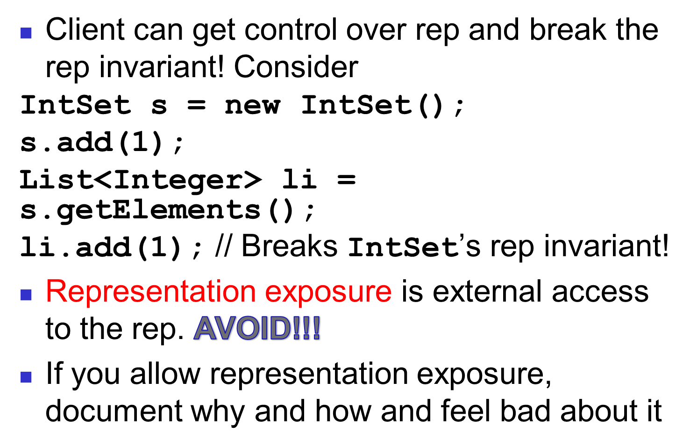
Representation Exposure

Slide 36
Representation Exposure
Make a copy on the way out:
public List<Integer> getElements() {
return new ArrayList<Integer>(data);
}
Mutating a copy does not affect IntSet’s rep
IntSet s = new IntSet();
s.add(1);
List<Integer> li = s.getElements();
li.add(1); //mutates new copy, not IntSet’s rep
Spring 18 CSCI 2600, K. Kuzmin, A Milanova

Slide 37
Representation Exposure
Make a copy on the way in too:
public IntSet(ArrayList<Integer> elts) {
data = new ArrayList<Integer>(elts);
…
}
Why?
Spring 18 CSCI 2600, K. Kuzmin, A Milanova

Slide 38
Representation Exposure
How about this:
class Movie {
private String title;
…
public String getTitle() {
return title;
}
}
Technically, there is representation exposure
Representation exposure is dangerous when the rep is mutable
  If the rep is immutable, it’s ok

Slide 39
Immutability, again
Suppose we add an iterator
// returns: an Iterator over the IntSet
public Iterator iterator();
Suppose the following implementation:
public Iterator iterator() {
return new Iterator(data);
}
Spring 18 CSCI 2600, K. Kuzmin, A Milanova

Slide 40
Immutability, again
class Iterator {
private List<Integer> theData;
private int next;
public Iterator(List<Integer> data) {
theData = data;
next = 0; _x0018__x0013_
}
public boolean hasNext() {
return (next < theData.size());
}
public int next() {
return theData.get(++next);
}
}
Spring 18 CSCI 2600, K. Kuzmin, A Milanova

Slide 41
Checking Rep Invariant
checkRep() or repOK()
Always check if rep invariant holds when debugging
Leave checks anyway, if they are inexpensive
Checking rep invariant of IntSet
private void checkRep() {
for (int i=0; i<data.size; i++)
if (data.indexOf(data.elementAt(i)) != i)
throw RuntimeException(“duplicates!”);
}
Spring 18 CSCI 2600, K. Kuzmin, A Milanova

Slide 42
Practice Defensive Programming
Assume that you will make mistakes
Write code to catch them
  On method entry
    Check rep invariant (i.e., call checkRep())
    Check preconditions (requires clause)
  On method exit
    Check rep invariant (call checkRep())
    Check postconditions
Checking rep invariant helps find bugs
Reasoning about rep invariant helps avoid bugs
Spring 18 CSCI 2600, K. Kuzmin, A Milanova (based on notes by Michael Ernst)

Slide 43
Aside: Invariants
Why focus so much on invariants?
  Loop invariants, rep invariants, immutability, which is a kind of invariant (immutable ADTs; modifies and effects clauses in the specification)
Software is complex
  Lots of interactions between different “modules”. Interactions is what makes reasoning difficult
  Lots of “moving parts” (i.e., lots of changes)
Spring 18 CSCI 2600, K. Kuzmin, A Milanova

Slide 44
Aside: Invariants
Invariants are properties that stay unchanged. Reduce intellectual complexity
If we know that some property stays unchanged, we can focus on other properties
Reducing the number of things we need to think about can be of great benefit
Spring 18 CSCI 2600, K. Kuzmin, A Milanova (based on slides by Michael Ernst)

Slide 45
Connecting Implementation to Specification
Representation invariant: Object → boolean
  Indicates whether data representation is well-formed. Only well-formed representations are meaningful
  Defines the set of valid values
Abstraction function: Object → abstract value
  What the data representation really means
    E.g., array [2, 3, -1] represents –x² + 3x + 2
  How the data structure is to be interpreted
Spring 18 CSCI 2600, K. Kuzmin, A Milanova (based on slides by Michael Ernst)
Notes:
But how do we know that our implementation is correct?

Slide 46
Abstraction Function: rep → abstract value
The abstraction function maps valid concrete data representation to the abstract value it represents. I.e., domain is all reps that satisfy the rep invariant
AF: Object → abstract value
The abstraction function lets us reason about behavior from the client perspective
Spring 18 CSCI 2600, K. Kuzmin, A Milanova (based on a slide by Michael Ernst)

Slide 47
Abstraction Function Example
class Poly {
// Rep invariant: degree = coeffs.length-1
// coeffs[degree] != 0
private int[] coeffs;
private int degree;
// Abstraction function: coeffs [a₀,a₁,…a_{degree}]
// represents polynomial
// a_{degree}x^{degree} + … + a₁x + a₀
// E.g., array [-2,1,3] → 3x² + x - 2
// Empty array represents the 0 polynomial
…
Spring 18 CSCI 2600, K. Kuzmin, A Milanova
Notes:
Because the AF is defined only on valid rep, we don’t have to worry that the last element of the array is 0.

Slide 48
Another Abstraction Function Example
class IntSet {
// Rep invariant:
// data contains no nulls and no duplicates
private List<Integer> data;
// Abstraction function: data [a₁,a₂,…a_{n}]
// represents the set { a₁, a₂, … a_{n} }.
// Empty list represents {}.
…
public IntSet() …
Spring 18 CSCI 2600, K. Kuzmin, A Milanova
Notes:
Again, valid rep.

Slide 49
Abstraction Function: mapping rep to abstract value
Abstraction function: Object → abstract value
  I.e., the object’s rep maps to abstract value
    IntSet e.g.: list [2, 3, 1] → { 1, 2, 3 }
  Many objects map to the same abstract value
    IntSet e.g.: [2, 3, 1] → { 1, 2, 3 } and
    [3, 1, 2] → { 1, 2, 3 } and [1, 2, 3] → { 1, 2, 3 }
Not a function in the opposite direction
  One abstract value maps to many objects
Spring 18 CSCI 2600, K. Kuzmin, A Milanova
Notes:
Why is it that we are not interested in a function in the opposite direction: i.e., abstract Value -> Object?

Slide 50
Another (Implementation of) IntSet
What if we dropped the “no duplicates” constraint from the rep invariant
class IntSet {
// Rep invariant: data contains no nulls
private List<Integer> data;
…
Can we still represent the concept of the IntSet? (Remember, an IntSet is a mutable set of integers with no duplicates.)
Spring 18 CSCI 2600, K. Kuzmin, A Milanova

Slide 51
Yes. First, we have to change the abstraction function
class IntSet {
// Rep invariant: data contains no nulls
private List<Integer> data;
// Abstraction function: List data
// represents the smallest set
// { a₁, a₂, … a_{n} } such that each a_{i} is
// in data. Empty list represents {}.
…
public IntSet() …
Spring 18 CSCI 2600, K. Kuzmin, A Milanova

Slide 52
Another IntSet
class IntSet {
// Rep invariant: data contains no nulls
private List<Integer> data;
…
[1,1,2,3] → { 1, 2, 3 }
[1,2,3,1] → { 1, 2, 3 }
etc.
There are many objects that correspond to the same abstract value
Spring 18 CSCI 2600, K. Kuzmin, A Milanova

Slide 53
Another IntSet
We have to change implementation of operations as well
What is the implication for add(int x) and remove(int x)? For size()?
add(int x) no longer needs check contains(x). Why?
remove(int x) must remove all occurrences of x in data. Why?
What about size()? What else?
Spring 18 CSCI 2600, K. Kuzmin, A Milanova
Notes:
How about equals()???

Slide 54
Correctness
Abstraction function allows us to reason about the implementation
_x0016_
Abstract operation:
_x0016_
Abstract value
Abstract value’
AF:
AF:
Concrete operation
(i.e., our implementation
of operation):
_x0016_
_x0016_
Concrete object
Concrete object’
Spring 18 CSCI 2600, K. Kuzmin, A Milanova
Notes:
If we take a concrete object, apply AF, get Abstract value.

Slide 55
IntSet Example
Abstract remove(1):
this – { 1 }
_x0016_
_x0016_
{ 1,2,3 }
{ 2,3 }
AF:
AF:
Concrete remove(1)
_x0016_
_x0016_
[2,1,1,2,3]
[2,2,3]
Creating concrete object:
Establish rep invariant
Establish abstraction function
After every operations:
Maintains rep invariant
Maintains abstraction function
Spring 18 CSCI 2600, K. Kuzmin, A Milanova
Notes:
If we take a concrete object, apply AF, get Abstract value.

Slide 56
Aside: the Rep Invariant
Which implementation is better
class IntSet {
// Rep invariant:
// data has no nulls and no duplicates
…
// methods establish & maintain invariant
// and original abstraction function
or
class IntSet {
// Rep invariant: data has no nulls
…
// methods maintain this weaker invariant
// and new abstraction function

Slide 57
Aside: the Rep Invariant
Often one role of the rep invariant is to simplify the abstraction function (by limiting valid concrete values which limits the domain of the abstraction function)
Consequently, rep invariant simplifies implementation and reasoning!
Spring 18 CSCI 2600, K. Kuzmin, A Milanova

Slide 58
Implementing an ADT: Summary so far
Rep invariant
  Defines the set of valid objects (concrete values)
Abstraction function
  Defines, for each valid object, which abstract value it represents
Together they modularize the implementation
  Can reason about operations in isolation
  Neither is part of the ADT abstraction!!!
Spring 18 CSCI 2600, K. Kuzmin, A Milanova (slide by Michael Ernst)

Slide 59
Implementing an ADT: Summary so far
In practice
  Always write a rep invariant!
  Write an abstraction function when you need it
    Write a precise and concise, but relatively informal abstraction function
    A formal one is hard to write, and often not that useful
    [As always with specs: we look for the balance between what is “formal enough to do reasoning” and what is “humanly readable and useful”
Spring 18 CSCI 2600, K. Kuzmin, A Milanova (slide by Michael Ernst)

Slide 60
Outline
Reasoning about ADTs
  Representation invariants (rep invariants)
  Representation exposure
  Checking rep invariants
  Abstraction functions
Review and practice problems
Spring 18 CSCI 2600, K. Kuzmin, A Milanova

Slide 61
Connecting Implementation to Specification
Representation invariant: Object → boolean
  Indicates whether data representation is well-formed. Only well-formed representations are meaningful
  Defines the set of valid values
Abstraction function: Object → abstract value
  What the data representation really means
    E.g., array [2, 3, -1] represents –x² + 3x + 2
  How the data structure is to be interpreted
Spring 18 CSCI 2600, K. Kuzmin, A Milanova (based on slides by Michael Ernst)

Slide 62
Rep Invariant Excludes Meaningless Concrete Values
Disallows meaningless values
  E.g., a RightTriangle cannot have base = -2
Ensures fields are properly synchronized
  volume and contents in BallContainer
  amount and transactions list in Account
  degree and coeffs array in Poly
Ensures specific data structure constraints
  A Tree cannot have cycles
Other correctness constraints
  0 <= index < names.length, names!=null

Slide 63
Checking Rep Invariant
checkRep() or repOK()
Checking “no duplicates” rep invariant of IntSet
private void checkRep() {
for (int i=0; i<data.size; i++)
if (data.indexOf(data.elementAt(i)) != i)
throw RuntimeException(“duplicates!”);
}
Always check if rep invariant holds when debugging
Leave checks anyway, if they are inexpensive

Slide 64
Practice Defensive Programming
Assume that you will make mistakes
Write code to catch them
  On method entry
    Check rep invariant (i.e., call checkRep())
    Check preconditions (requires clause)
  On method exit
    Check rep invariant (call checkRep())
    Check postconditions
Checking rep invariant helps find bugs
Reasoning about rep invariant helps avoid bugs
Spring 18 CSCI 2600, K. Kuzmin, A Milanova (based on notes by Michael Ernst)

